Slide 1


Data-Driven Storytelling Presentation
Driving Growth at JPMorgan Chase & Co.
A Comprehensive Analysis of Account Sales Performance
(2017-2021)
Prepared by: Aswin A

Slide 2
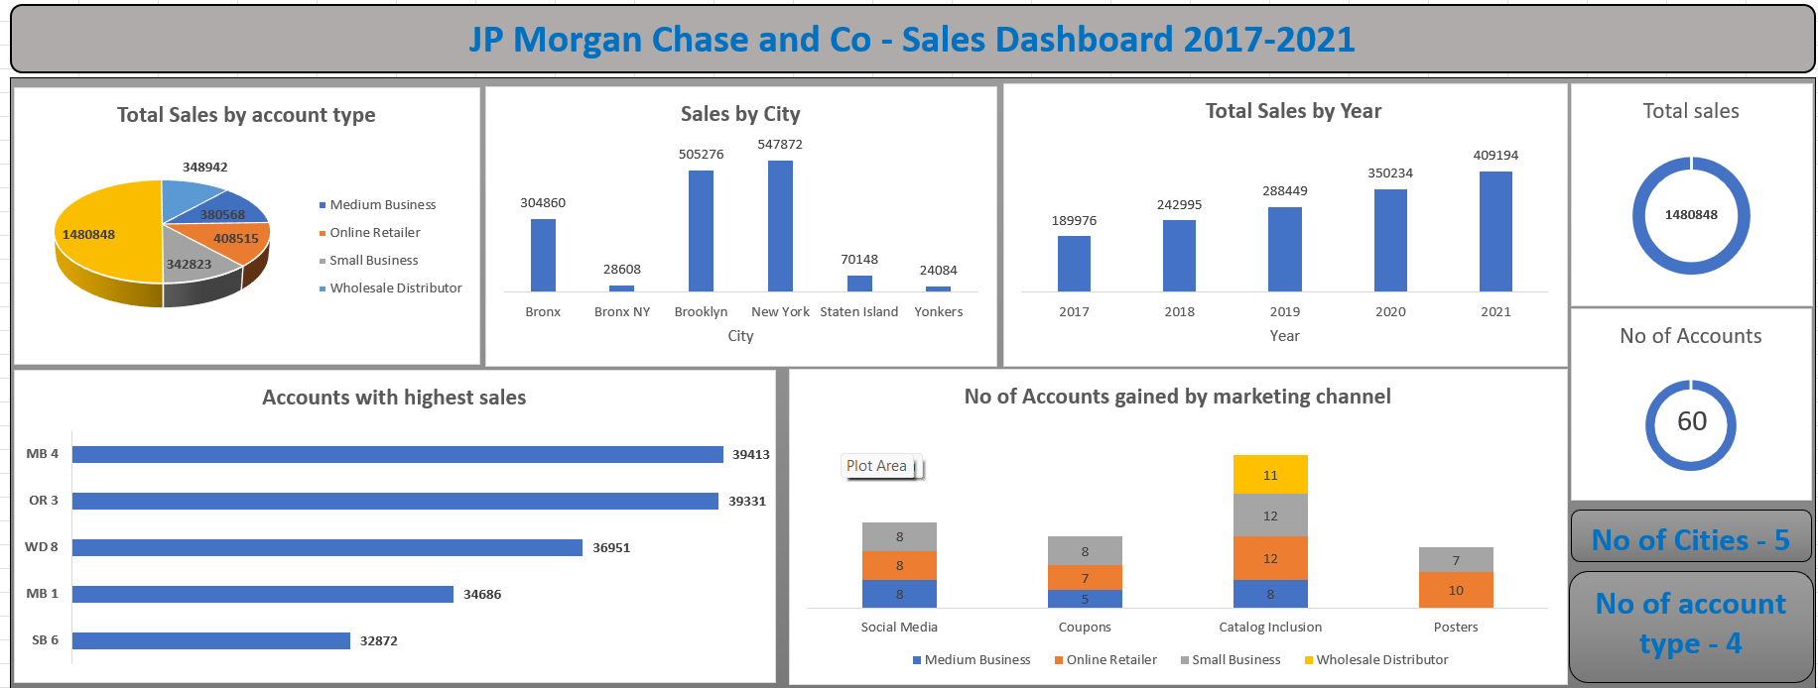
Dashboard - Presentation

Slide 3
Sales Insights
The total sales across all five cities and four account types amounted to 1,480,848 units.
Sales volumes reached their peak in the year 2021.
Year-over-year analysis indicates a consistent increase in sales volumes.
The highest sales volumes were observed in two key cities: New York and Brooklyn.
Among all account types, Online Retailers achieved the highest sales volumes.
Catalog Inclusion emerged as the most successful marketing channel, driving significant sales growth.
The account named MB 4 recorded the highest sales volume at 39,413 units, outperforming all 60 account names.

Slide 4
Summary
Year-over-year analysis indicates a consistent increase in sales volumes
Despite satisfactory overall sales performance, there is ample room for significant improvement.
Notably, the past five years have witnessed the most robust sales growth in the online retailer account category.
Strengthen relationships and customize offerings for the top 5 accounts to maximize sales and loyalty.
Thank you for the opportunity.

